Slide 1

Faculty of Engineering and Technology
Department of Computer Science and Engineering
Notes:
This is the title slide for respective colleges/institutions while we retain the DMIHER logo on top always.

Slide 2

PRESENTATION FOR
PROGRESS OF PBL TOPIC
INTELLIGENT MEDICAL AI DASHBOARD: PRIVACY-PRESERVING MULTIMODAL HEALTHCARE ANALYTICS
ROLL NUMBER : DMET1124033
NAME OF SCHOLAR: AKSHAT NIMJE
NAME OF THE SUPERVISOR: MS. LAKSHMI MADIREDDY
DATE : 18th July 2026

Slide 3
CONTENTS
Introduction
Literature survey and Research gap analysis
Summary of Research Gap
Research Question
Aim
Objectives
Methodology
TARGET OF THE NEXT THREE MONTHS
REFERENCES

Slide 4
INTRODUTION
The Data Bottleneck: Modern healthcare facilities generate vast amounts of fragmented data, including structured EMR tables, unstructured clinical guidelines, audio recordings, and medical imaging.
The Privacy Problem: Strict medical data privacy regulations (simulating HIPAA compliance) completely prohibit uploading sensitive patient vitals to public cloud AI services (e.g., OpenAI or Google cloud APIs).
The 'Black Box' Barrier: Clinicians heavily distrust predictive machine learning models if the AI cannot explain the exact mathematical reasoning behind its diagnosis.
The Proposed Solution: A fully offline, multi-modal Streamlit ecosystem driven entirely by edge-computed AI models (Qwen, Whisper, ViT), enabling secure, explainable clinical workflows.

Slide 5
LITERATURE SURVEY
Sr. No | Title of the Article, Authors and Year of publication | Focus of Study, Design, Objectives , Method used and Sample size | Findings of the study and conclusions | Remarks of the Scholar
1. | Deep Learning in Glaucoma Detection and Progression Prediction: A Systematic Review and Meta-Analysis Ling et al. (2025) | Focus: Meta-analysis of DL performance in diagnosis and progression. Method: Reviewed 48 studies using Fundus & OCT imaging. Sample: Aggregated data from >200k fundus and >17k OCT images. | Findings: Fundus imaging achieved Sensitivity of 0.92 and Specificity of 0.93. OCT achieved Sensitivity of 0.90. Conclusion: Internal testing showed higher accuracy than external validation | Provides a strong statistical baseline for my project. Highlights the "Generalizability Gap" in current AI models (performance drops on new external data).
2. | Equity-enhanced glaucoma progression prediction from OCT with knowledge distillation Afolabi et al. (2025) | Focus: Addressing algorithmic bias and data scarcity in progression prediction. Method: Proposed "FairDist" model using EfficientNet, Equity-Aware Attention, and Knowledge Distillation. Sample: 10,000 eyes (Detection), 500 eyes (Progression). | Findings: FairDist achieved the highest AUC (0.78) for rapid progression and significantly improved accuracy for Black and Asian subgroups compared to standard ResNet . | Validates the use of Knowledge Distillation to transfer learning from large detection datasets to smaller progression datasets, a key technique for my methodology.

Slide 6
LITERATURE SURVEY
Sr. No | Title of the Article, Authors and Year of publication | Focus of Study, Design, Objectives , Method used and Sample size | Findings of the study and conclusions | Remarks of the Scholar
3. | Deep Learning Approach Predicts Longitudinal Retinal Nerve Fiber Layer Thickness Changes Jalili et al. (2025) | Focus: Predicting future RNFL thickness changes (structural progression). Method: Developed a custom 1D-CNN vs. Linear Regression. Sample: Longitudinal data from 437 eyes (251 participants). | Findings: Custom 1D-CNN outperformed traditional regression with an $R^2$ of 0.94-0.98 and Mean Absolute Error of just 2.0-4.2 µm ³. | Proves that CNNs can accurately forecast continuous structural variables (thickness), not just binary classification (Healthy vs. Glaucoma).
4. | Artificial Intelligence in Glaucoma: Advances in Diagnosis... and Surgical Outcome Prediction Lan et al. (2025) | Focus: Comprehensive review of AI in diagnosis, progression, and surgical outcomes. Method: Qualitative review of deep learning, ML, and multi-modal models. Sample: Reviewed diverse studies on OCT, Fundus, and Omics data. | Findings: AI can detect subtle changes beyond human observation. Identified "Interpretability" (Black Box nature) and "Data Heterogeneity" as major remaining challenges. | Helps define the "Problem Statement" regarding the lack of explainability in AI, suggesting we should focus on interpretable models.

Slide 7
LITERATURE SURVEY
Sr. No | Title of the Article, Authors and Year of publication | Focus of Study, Design, Objectives , Method used and Sample size | Findings of the study and conclusions | Remarks of the Scholar
5. | Prediction of Visual Field Progression from OCT Structural Measures in moderate to advanced Glaucoma Nouri-Mahdavi et al. (2021) | Focus: Predicting functional (Visual Field) loss using structural (OCT) data. Method: Used Elastic Net Regression (ENR) and Machine Learning (Naïve Bayes, RF, SVM). Sample: 104 eyes with moderate to advanced glaucoma. | Findings: Machine Learning (Naïve Bayes) achieved the best AUC (0.81). Macular GCIPL measures were better predictors than RNFL in advanced cases . | Establishes the biological correlation between structural damage (OCT) and functional vision loss, justifying the use of multimodal data.
6. | Artificial Intelligence and Advanced Technology in Glaucoma: A Review Tonti et al. (2024) | Focus: Review of AI in personalized medicine and teleophthalmology. Method: Systematic search of PubMed/Scopus for ML/DL Applications. Sample: Reviewed 60 papers on diagnosis and treatment optimization. | Findings: AI enables "Risk Stratification" (identifying high-risk patients early). Highlighted the potential of AI in teleophthalmology for remote monitoring . | Supports the "Societal Impact" of the project, showing how AI can democratize access to glaucoma screening in underserved areas.

Slide 8
Summary of Research Gap
Cloud Dependency Risk: Existing medical assistants heavily rely on external APIs, creating a massive vulnerability regarding patient data leakage.
Siloed Modalities: Most clinical AI frameworks handle only vision, only audio, or only text—failing to combine them into a singular diagnostic environment.
Lack of Actionable Explainability: Tree-based and deep learning diagnostic models rarely provide the instant feature-level transparency that physicians require during live screening.

Slide 9
RESEARCH QUESTION
How can a fully offline, edge-computed multi-modal AI architecture—integrating speech recognition, generative natural language query writing, supervised predictive ML with feature-level explainability, unsupervised anomaly detection, and vision transformers—be engineered to create a secure clinical decision platform?

Slide 10
AIM
To design, implement, and validate a localized, multi-modal AI dashboard that processes natural language voice queries, generates automated database analysis, forecasts patient health risks with high explainability, purifies data quality via anomaly detection, and scans radiological imaging entirely on host hardware.

Slide 11
OBJECTIVES
Build a Speech-to-SQL Pipeline: Quantize a local automatic speech recognition (ASR) engine and LLM to seamlessly run text-to-SQL tasks.
Integrate Supervised Risk Modeling: Train a Random Forest classifier on standardized heart disease records to deliver real-time risk percentages.
Embed an Explainability Engine: Wire SHAP value extraction into the user interface to generate structural breakdown graphs of clinical variables.
Engineer an Unsupervised Auditor: Utilize an Isolation Forest configuration to flag data anomalies inside hospital tables.
Deploy Multimodal Capabilities: Add a Vector Space Search engine (TF-IDF/Cosine Similarity) for medical PDF processing (RAG) and a Vision Transformer (ViT) for automated Pneumonia detection in X-Rays.

Slide 12
Methodology
Phase 1: Generative Clinical Assistant
Speech Translation: Faster-Whisper decodes voice inputs locally into standard string prompts.
Structured/Unstructured Hybrid Engine: Local Qwen routes text inputs either to generate executable SQLite code for the relational database or queries a local Vector Library built on TF-IDF matrices to scan raw medical PDFs.
Phase 2: Supervised Prognostics & Explainable AI
Classifier: A Scikit-Learn Random Forest model evaluates patient variables (Age, BP, Cholesterol).
Visual Interpretation: The model hooks into a SHAP explainer, converting raw prediction calculations into an interactive Streamlit waterfall plot that visualizes marginal feature contributions.

Slide 13
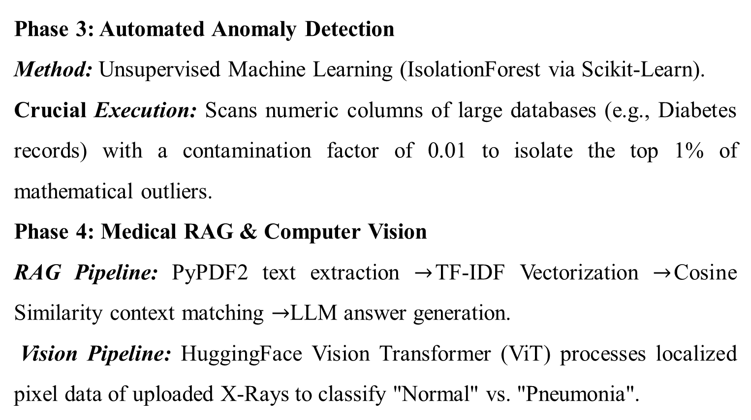
Methodology
Phase 3: Automated Anomaly Detection
Method: Unsupervised Machine Learning (IsolationForest via Scikit-Learn).
Crucial Execution: Scans numeric columns of large databases (e.g., Diabetes records) with a contamination factor of 0.01 to isolate the top 1% of mathematical outliers.
Phase 4: Medical RAG & Computer Vision
RAG Pipeline: PyPDF2 text extraction $→$TF-IDF Vectorization $→$Cosine Similarity context matching $→$LLM answer generation.
Vision Pipeline: HuggingFace Vision Transformer (ViT) processes localized pixel data of uploaded X-Rays to classify "Normal" vs. "Pneumonia".

Slide 14
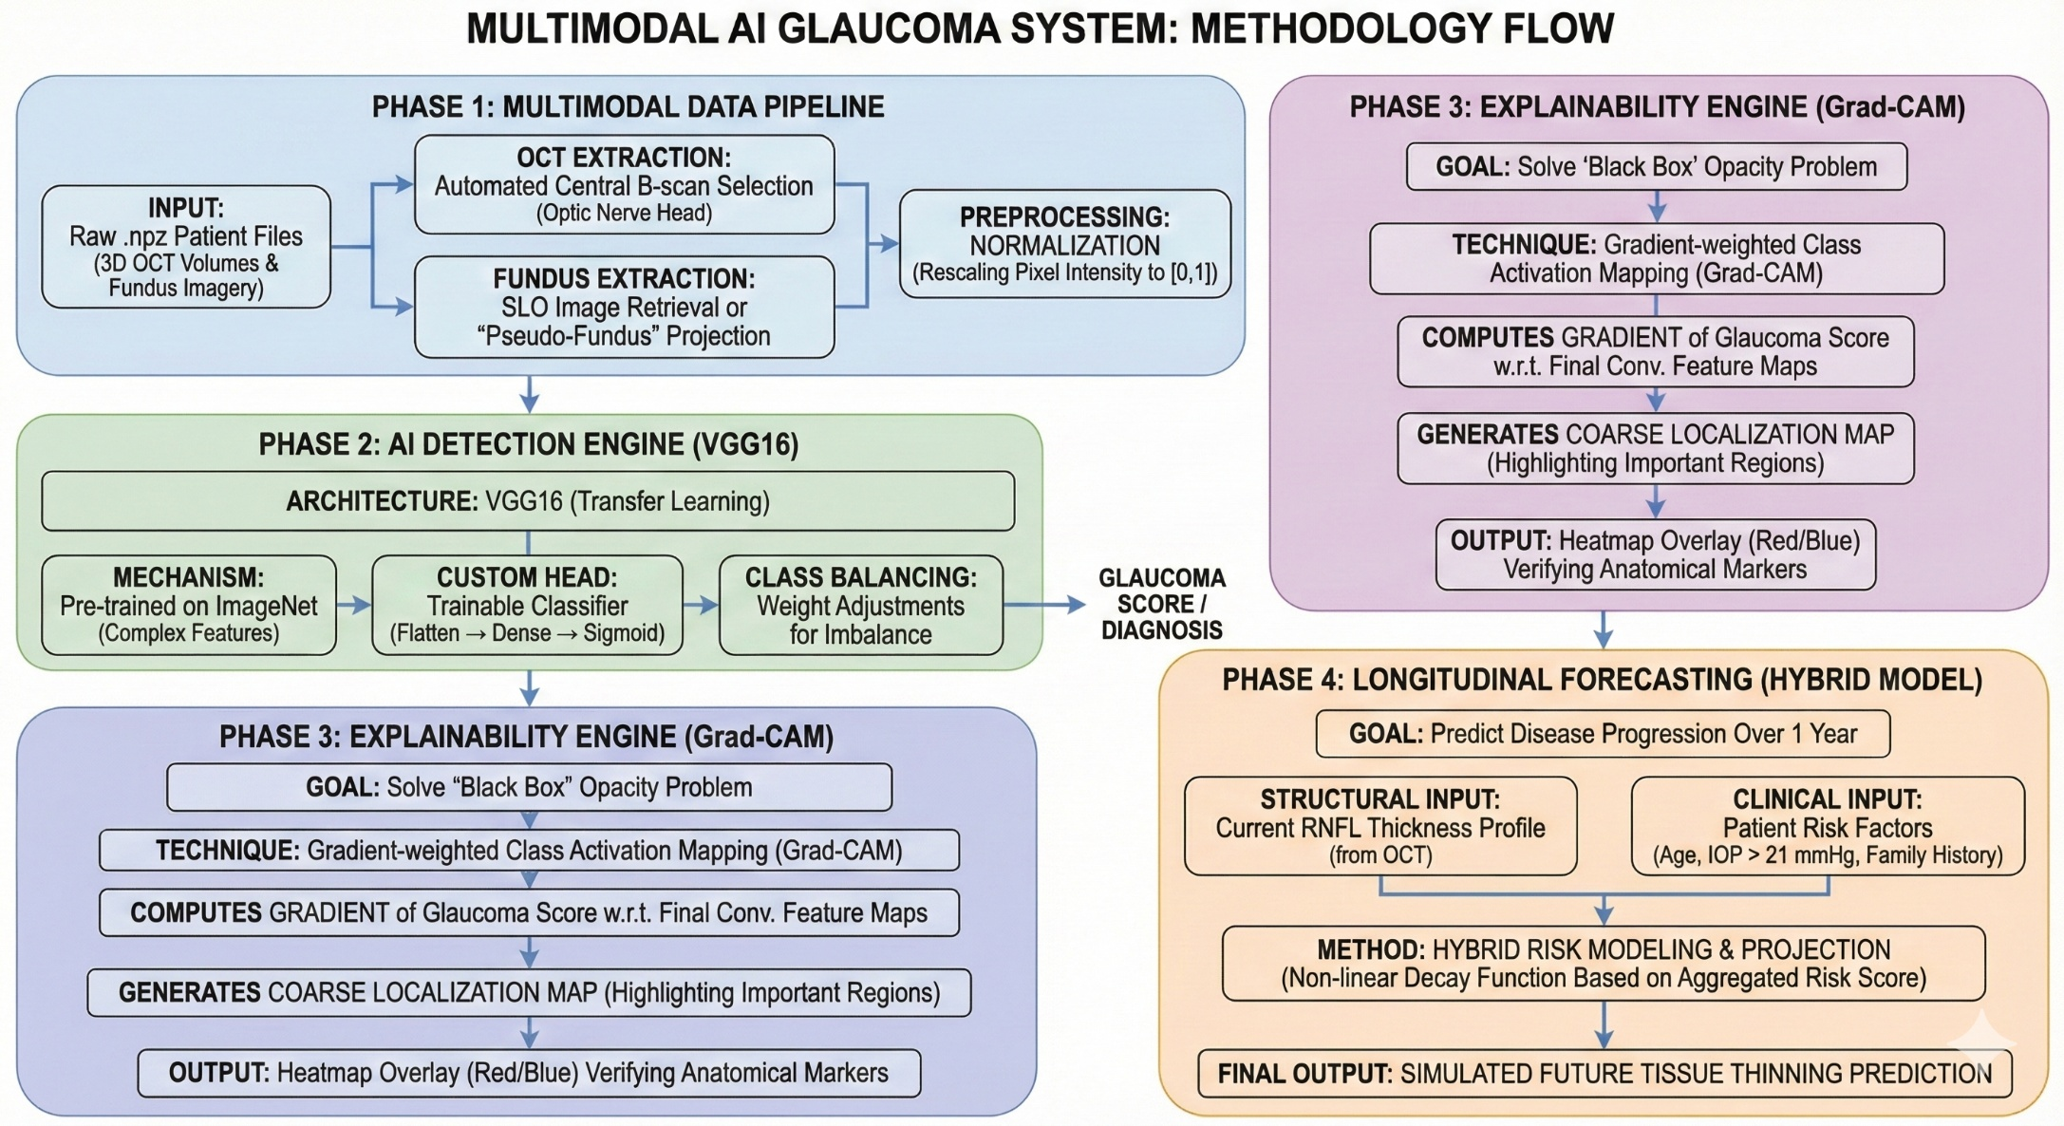
Methodology
.

Slide 15
TARGET OF NEXT THREE MONTHS
June(COMPLETED) | July(INCOMPLETED) | August (INCOMPLETED)
Complete GitHub deployment, finalize the README documentation, and record standard operation video demonstrations. | Conduct clinical validation testing by running novel dataset inputs through the Vision and Predictive ML modules to calculate accuracy metrics. | Draft and finalize the primary project thesis report; prepare for the final capstone presentation.
(Optimization): Enhance model optimization by testing lower-bit quantization schemes to further reduce local RAM load. | (Validation Testing): Load large benchmark medical datasets to log performance metrics (precision, recall, inference latency) for the diagnostic systems. | (Documentation): Complete the final capstone project report, generate comprehensive deployment guides on GitHub, and prepare for final presentation panels.

Slide 16
References
[1] Qwen Team. (2025). Qwen2.5-Coder: 1.5B Local Instruction-Tuned Model. HuggingFace.
[2] Lundberg, S. M., & Lee, S. I. (2017). A Unified Approach to Interpreting Model Predictions (SHAP). Advances in Neural Information Processing Systems.
[3] UCI Machine Learning Repository. (1988). Heart Disease Data Set. Cleveland Clinic Foundation.
[4] Pedregosa, F., et al. (2011). Scikit-learn: Machine Learning in Python. Journal of Machine Learning Research.
[5] Systran. (2023). Faster-Whisper: High-Performance Audio Transcription. GitHub Repository.
[6] E. Tonti et al., "Artificial intelligence and advanced technology in glaucoma: A review," J. Pers. Med., vol. 14, no. 10, Art. no. 1062, Oct. 2024, doi: 10.3390/jpm14101062.

Slide 17
😊 Thank You 😊

